Slide 1
Analysis of long-term physical status OF CHINESE PEOPLE for sharing fitness data TO SOCIAL MEDIA
Wenyu Tang
19028204

Slide 2
OUTLINE
1. Introduction
2.Background
3. Research Question
4. Methodology
5. Results
6.Conclusion

Slide 3
Introduction
More and more trackable devices have been introduced into our life.
The wide use of these devices changes and reform the way of our life.
Many researches shows that these devices can play positive roles for us to improve physical status.
(Study on the Effective Factors of Sports APP Promoting Persistence in Public Exercise by: shen wang 2017)
Social media also deeply affect our daily behaviors.

Slide 4
Background AND PREVIOUS RESEARCH
>Using wearable devices can significantly improve the enthusiasm for fitness.
( Wearable Devices as Facilitators, Not Drivers, of Health Behavior Change by: Ms Pastel2015)
>The mobile devices like apple watch are widely used nowadays and plays an important role for people tracking and controlling their physical data.
(Geuens J ，Swinnen TW，Westhovens R，et al. A Review of Persuasive Principles in Mobile Apps for Chronic Arthritis Patients: Oppor- tunities for Improvement. Jmir mhealth and uhealth ，2016，4 ( 4) : e118)
75% of sam fitness club members admit that sharing data to social media give them a feeling of achievement.
(Objectifying fitness: A content and thematic analysis of# fitspiration images on social media. N Deighton-Smith2018)
> But when the internet factor is included? What are the most important factors relateing to their practice behaviors?

Slide 5
HYPOTHESISES
H1: Social media plays take a positive effect for encouraging people to do body fitness.
H2: The time spent on work and other life businesses are the biggest negative factors in pattern to describe the regulation of the survey group.
H3: Have serious two-level differentiation of exercise effectiveness.

Slide 6
Methodology
1. Survey:
> Principles in my friend circle of Chinese social media – wechat. To let them finish the questionairies I sent .
> Data collection, extract and format to correspond to the program.
2. Analyze:
> Local weighted linear regression algorithm.
> Error handling for singular matrix.

Slide 7
Survey:
> Originally I list 15 factors for calculating the pattern, but considering the feedback from some of the users, I finally choose the 8 factors for principles in this survey to finish. 1. People age range from 18 - 40 years old.
2. Work time daily from 8-14 hours.
3. Gender
4. Daily numbers of sharing physical data to the social media. (result: 0 – 12)
5. How long they have been sharing the data. (range: 0 -36 months)
6. Their daily sleep time(range 6 -11 hours)
7. The transportation time. (range: 0.5-2.5 hours)
8. The feedback positive level(range: let them score from 0 - 10)

Slide 8
assessment standard
> Assesment standard:
How to define the status of physical body status? Different methods can be used :
e.p: body exam data: body fat index, blood pressure, heart beat rate etc
They are not appropriate for the human research request I submitted. So I finally simplify to use body
status feeling as the assessment standard(rate point: 1 to 10) .

Slide 9
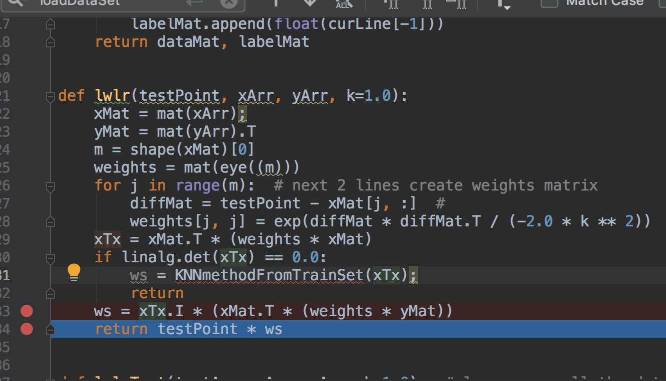

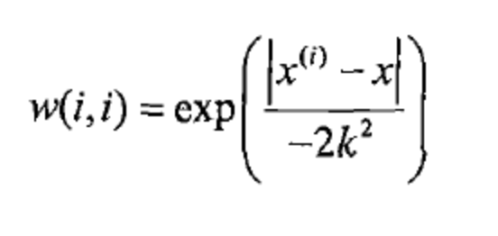

Analyze
> algorithm I use:
Theory: a quadratic function，
Weight function（fitting function）

Slide 10
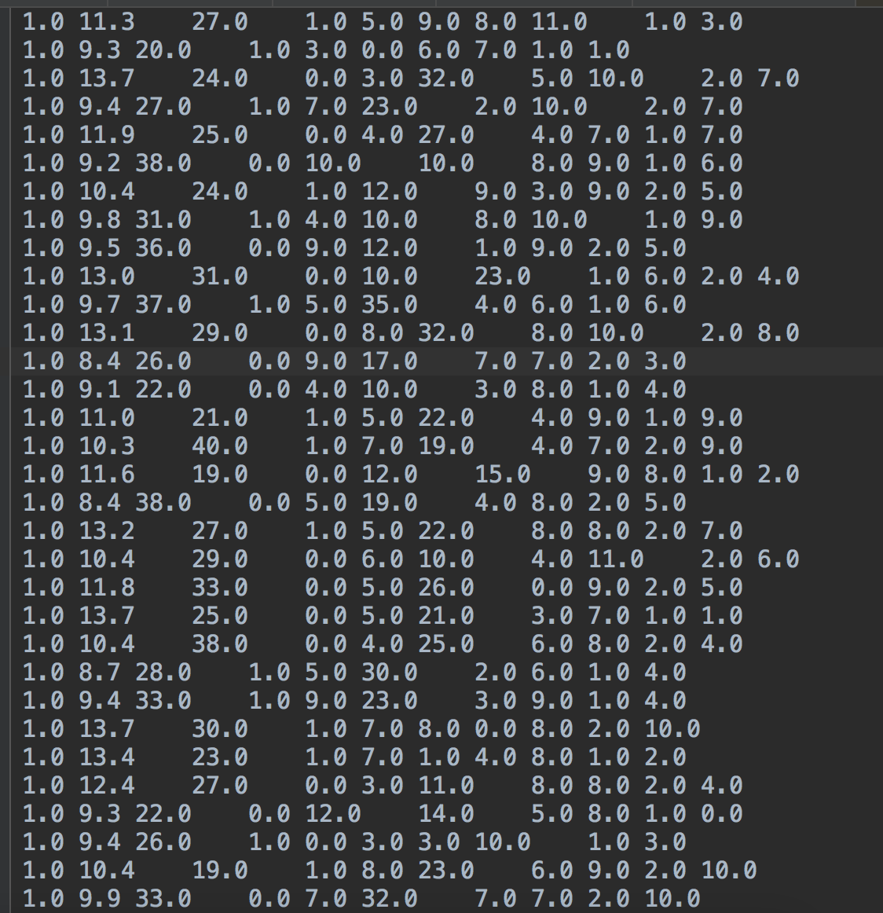
TRAIN SET
Toatal 62 samples:

Slide 11
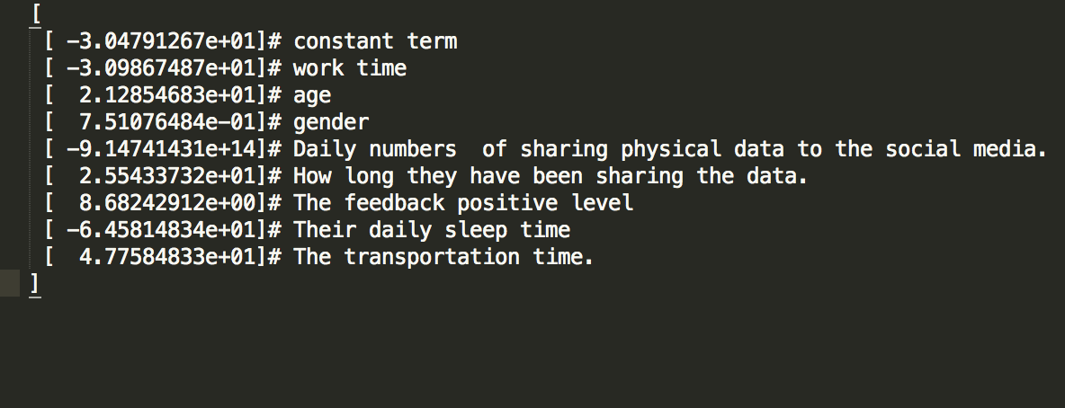
Result
Final Coefficient matrix:

Slide 12
Conclusion:
1. Gender and feedback positive level are the most important factors for long term insist and body fitness effect.
2. Work time did play a negative role for doing body fitness. Sleep too long seems also negative for people go to the gym.
3. Some factors are beyond my expectation, daily number of sharing data to social media is significant negative for improving physical status(may be too frequently sharing people don’t focus on exercise) and longer transportation time is positive for the pattern.

Slide 13
Limitation
Small samples involved.
Need to compare and find a better algorithm suitable for this scenario. May be more effective.

Slide 14
Reference:
1 Geuens J ，Swinnen TW，Westhovens R，et al. A Review of Persuasive Principles in Mobile Apps for Chronic Arthritis Patients: Oppor- tunities for Improvement. Jmir mhealth and uhealth ，2016，4 ( 4) : e118.
2 Kylef P，& Luc J M. Team Building in Sport: Linking Theory and Research to Practical Application. Journal of Sport Psychology in Ac- tion，2012，3: 159 - 170.
3 Bassett-Gunter R，& Chang A. Self-Regulatory Self-Efficacy，Action Control，and Planning: There's an App for That. Telemedicine and e - health，2016，22 ( 4) : 325 - 331.
4 Belmon，LS，Middelweerd，A，Tevelde，SJ，& Brug，J. Dutch Young Adults Ratings of Behavior Change Techniques Applied in Mo- bile Phone Apps to Promote Physical Activity: A Cross-Sectional Survey. Jmir mhealth and uhealth，2015，3 ( 4) : 68 - 81.
5 Cowan L T，Van Wagenen S A，Brown B A，Hedin R J，Seino-Stephan Y，Hall P C，West J H. Apps of steel: are exercise apps providing consumers with realistic expectations: A content analysis of exercise apps for presence of behavior change theory[J]. Health Educ Behav

Slide 15
6 F o x S ，D u g g a n M . M o b i l e H e a l t h 2 0 1 2 [ R B / O L ] ]. http: / /www. pewinternet. org/ 2012/11/08/mobile-health -2012/.
7 (US) John Ratey, Eric Hagerman. Sports to transform the brain
[M]. Pu Rong Translation. Hangzhou: Zhejiang People's Publishing House, 60-61.
8 "Health China, 2 0 2 " Strategic Research Report Editorial Board . "Health
China 2020 Strategy Research Report [M]. Beijing: People's Health
Publisher, 2012: 44.
9 (US) Charles Duhigg. The power of habit [M]. Wu Hao
Jun ( Beijing ) : CITIC Publishing House,
8 4 -8 7 .
10 He Buwen. On the formation and lifelong life of college students' physical exercise habits Sports [J]. Journal of Lanzhou University: Social Science Edition (S2) : 413-414.
Study on the Effective Factors of Sports APP Promoting Persistence in Public Exercise by: shen wang 2017

